Slide 1
INTRODUCTION TO LaMBDA EXPRESSIONS
IT 301

Slide 2
Topics
What is Functional Programming?
What are Lambda Expressions?
Lambda Expression Advantages
How to pass Lambda Expressions to methods

Slide 3
What is Functional Programming?
A style of programming that emphasizes the use of functions(methods) to decompose a complex task into subtasks
Examples of functional languages
LISP, Scheme, Haskell, F#
Java is considered an object-oriented language, not a functional language
But Java 8(2014) introduced features like lambda expressions that allow for a partial functional programming style

Slide 4
What are Lambda Expressions?
Lambda Expressions describe a function by specifying its parameters and return value
Syntax:
(parameters) → expression
Example:
(n) → n * n //squares a number
Note: The arrow → symbol is a tell-tale sign you are viewing a lambda expression
Note: By convention the parameter names are just one letter

Slide 5
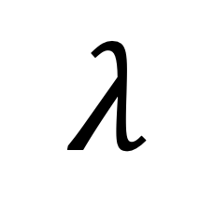
Advantages of Lambda Expressions
More concise code – easier to read (once you understand the syntax)
Programmers can pass code blocks easily
Simplifies code for event handlers, comparators, and when processing streams(coming soon)
$$λ$$

Slide 6
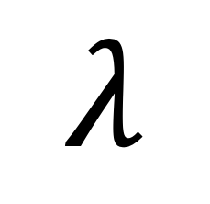
Math Quiz Example
$$λ$$
Consider a program that gives integer math quiz problems to the user:
9 + 6 = 15
you are brilliant!!!
3 * 7 = 18
incorrect...the answer was 21
How do we generalize the idea of "add or multiply"?
How much work would it be to add other operators?
Would functional programming/lambda expressions help?

Slide 7
Functional Interfaces
$$λ$$
Functional interfaces are in the java.util.function package
import java.util.function.*;
These interfaces contain one abstract method
These functions can take in arguments and return results
Lambda expressions can be used to create these functions
public interface IntBinaryOperator { public abstract int applyAsInt(int left, int right); }
return
public interface DoubleBinaryOperator { public abstract double applyAsDouble(double left, double right); }

Slide 8
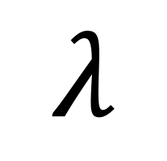
Simplest Lambda Expressions
$$λ$$
In their simplest form, a lambda expression contains
1) parameters inside ( )’s
(int x, int y)
2) An arrow →
3) An expression that is being computed from the list of parameters
x + y
You will put the pieces together and often pass to a method
(x, y ) → x + y
Optional

Slide 9
Passing Lambda Expressions to Methods
$$λ$$
We can pass a lambda expression(anonymous function) to a method so each time the method is called a different math problem is generated
One lambda expression to represent addition problem
mathQuiz(“+”, (x, y) → x + y);
Another lambda expression to represent multiplication
mathQuiz(“*”, (x, y) → x * y);
We can even add an expression to represent bitwise &
mathQuiz(“&”, (x, y) → x & y);

Slide 10
mathQuiz method
$$λ$$
public static void mathQuiz(String op, IntBinaryOperator operator) { Scanner kb = new Scanner(System.in); Random r = new Random(); final int MAX = 12; // Generate two random numbers for math problems range 1 - 12 int x = r.nextInt(MAX) + 1; int y = r.nextInt(MAX) + 1; System.out.print(x + " " + op + " " + y + " = "); // calculate answer using the lambda expression passed in int answer = operator.applyAsInt(x, y); // get user's answer int response = kb.nextInt(); String status = (response == answer ) ? "you are brilliant!!!" : "incorrect...the answer was "+answer; System.out.println(status); }
(x, y) → x + y

Slide 11
Learning Practice 1 – DoubleBinaryOperator
Goal: Create a program that creates Lambda Expressions which implement the applyAsDouble(double left, double right) abstract method found in theDoubleBinaryOperator interface.
2. Your main method in DoubleTester.java should prompt the user to enter two decimal numbers and pass theses numbers, a Lambda Expression and a string of text that describes the calculation. Calculation ideas: area of rectangle, a difference, perimeter of rectangle, etc.
3. Then write a method called produceAnswers() that will accept the four parameters: double, double, String, DoubleBinaryOperator and produce the answer using the lambda expression. Make sure you call produceAnswers with three different lambda expressions:
Some sample output is on the next slide…….

Slide 12
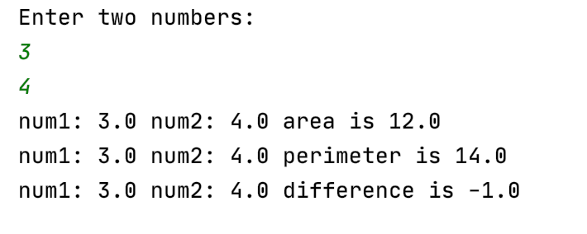
Learning Practice 1 – DoubleBinaryOperator
Sample Output:

Slide 13
Another Simple Lambda Expression
Here, our lambda expression contains
1) parameters inside ( )’s
(Dog p1, Dog d2)
2) An arrow →
3) An expression that is being computed from the list of parameters
d1.getAge() – d2.getAge()
We will put these pieces together and pass to a Collections.sort() method
(d1, d2 ) → d1.getAge() – d2.getAge()
Optional

Slide 14
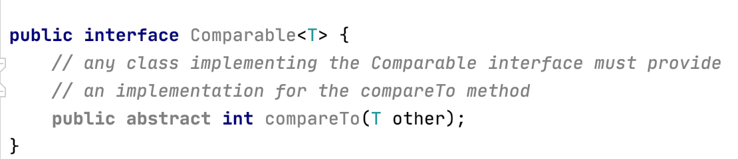
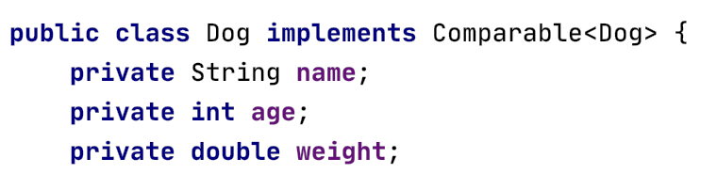
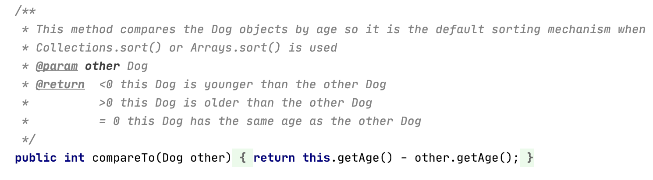
Review Comparable<T> Interface

Slide 15
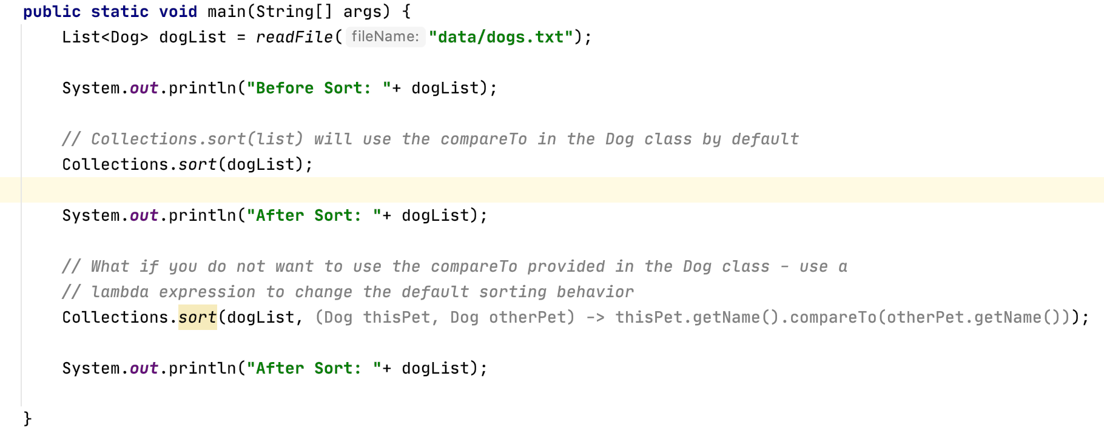
Passing Lambda Expressions to Methods
Lambda Expression

Slide 16
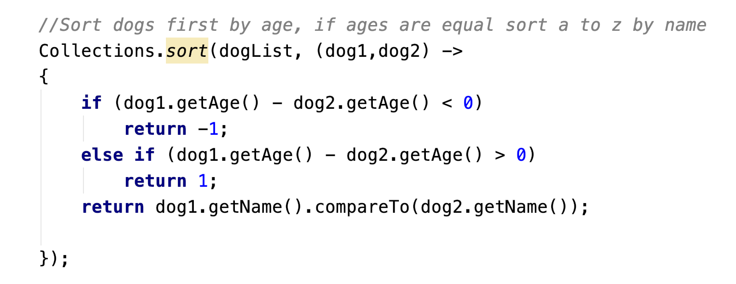
Passing Complex Lambda Expressions
If you have more than one statement in your Lambda Expression, you must put the java statements in curly braces

Slide 17
Learning Practice 2 – Sorting Strings
1. Open the learningprac2 package from your LambdaDemo project and modify the SortingStrings.java file by….
2. Adding a call to Collections.sort( ) which will sort the wordList by the length of the word (shortest to longest) using a simple lambda expression.
Before Sort: [hoppy, sad, fish, pop, fresh, cat, happy]
After Sort: [sad, pop, cat, fish, hoppy, fresh, happy]
3. Adding a second call to Collections.sort() which will sort the wordList by the length of the word and if the lengths are equal it will sort the words alphabetically
Before Sort: [hoppy, sad, fish, pop, fresh, cat, happy]
After Sort: [cat, pop, sad, fish, fresh, happy, hoppy]

